Slide 1
Statistical Machine Translation
Jurafsky, D. and Martin, J. H. (2009): Speech and Language Processing. An Introduction to Natural Language Processing, Computational Linguistics and Speech Recognition. Second Edition. Pearson: New Jersey: Chapter 25
Material von Bonnie Dorr’s lecture
Material from Kevin Knight’s lecture at Berkeley, 2004
noisy channel model, word alignment, phrase-based translation
01/07/20
Language Technology Group – Chris Biemann

Slide 2
Why is MT challenging?
Because languages are hard, even for humans!
What is the German equivalent of “It is all Greek to me”?
01/07/20
Language Technology Group – Chris Biemann

Slide 3
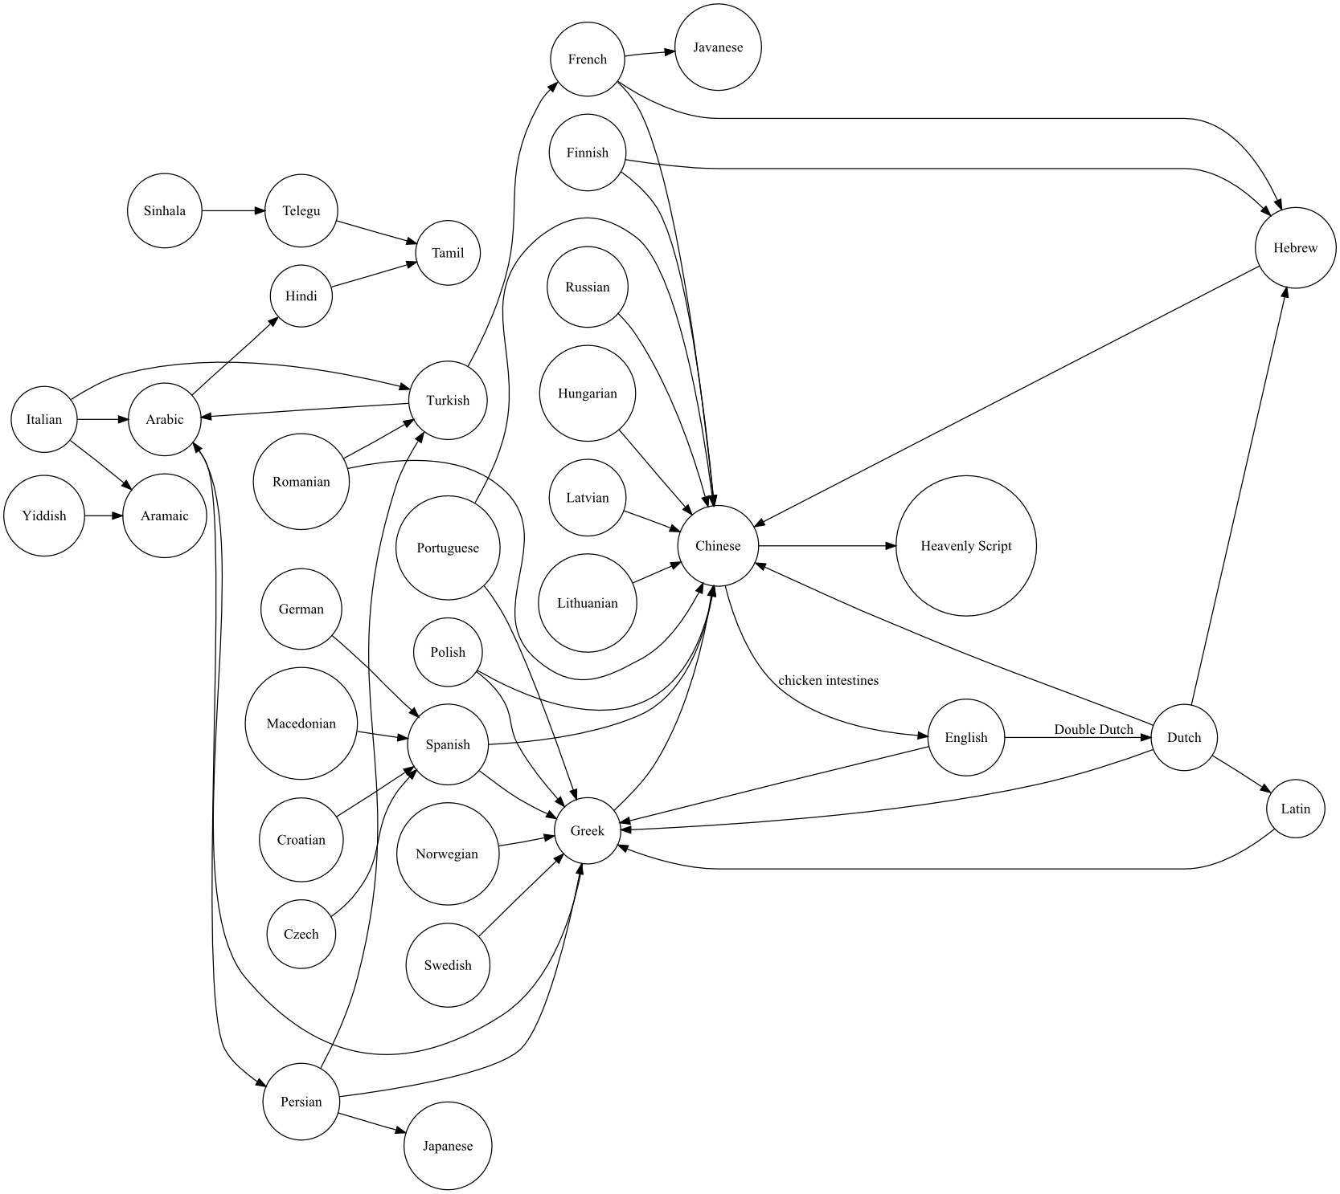
Why is MT challenging?
Because languages are hard, even for humans!
What is the German equivalent of “It is all Greek to me”?
01/07/20
Language Technology Group – Chris Biemann

Slide 4
There are around 7,097 languages worldwide but 40% are threatened
Why is MT challenging?
01/07/20
Language Technology Group – Chris Biemann
Notes:
a minority language
Xhosa which is spoken by 7 million people in South Africa
a less-studied language
Turkish which is spoken by around 88 million people
a resource poor language
Bengali although it is spoken by around 200 million people

Slide 5
Why is MT challenging?
95% of the population speak only 300 of them
01/07/20
Language Technology Group – Chris Biemann
Notes:
a minority language
Xhosa which is spoken by 7 million people in South Africa
a less-studied language
Turkish which is spoken by around 88 million people
a resource poor language
Bengali although it is spoken by around 200 million people

Slide 6

MT epic fails
01/07/20
Language Technology Group – Chris Biemann

Slide 7

MT epic fails
01/07/20
Language Technology Group – Chris Biemann

Slide 8

MT epic fails
01/07/20
Language Technology Group – Chris Biemann

Slide 9

MT epic fails
01/07/20
Language Technology Group – Chris Biemann

Slide 10

MT epic fails
The Arabic is a transliteration of Meat balls in Arabic alphabet, with its English literal translation as “Paul is dead”
01/07/20
Language Technology Group – Chris Biemann

Slide 11
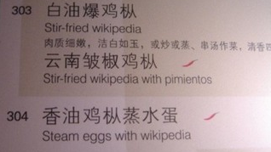
MT epic fails
01/07/20
Language Technology Group – Chris Biemann

Slide 12
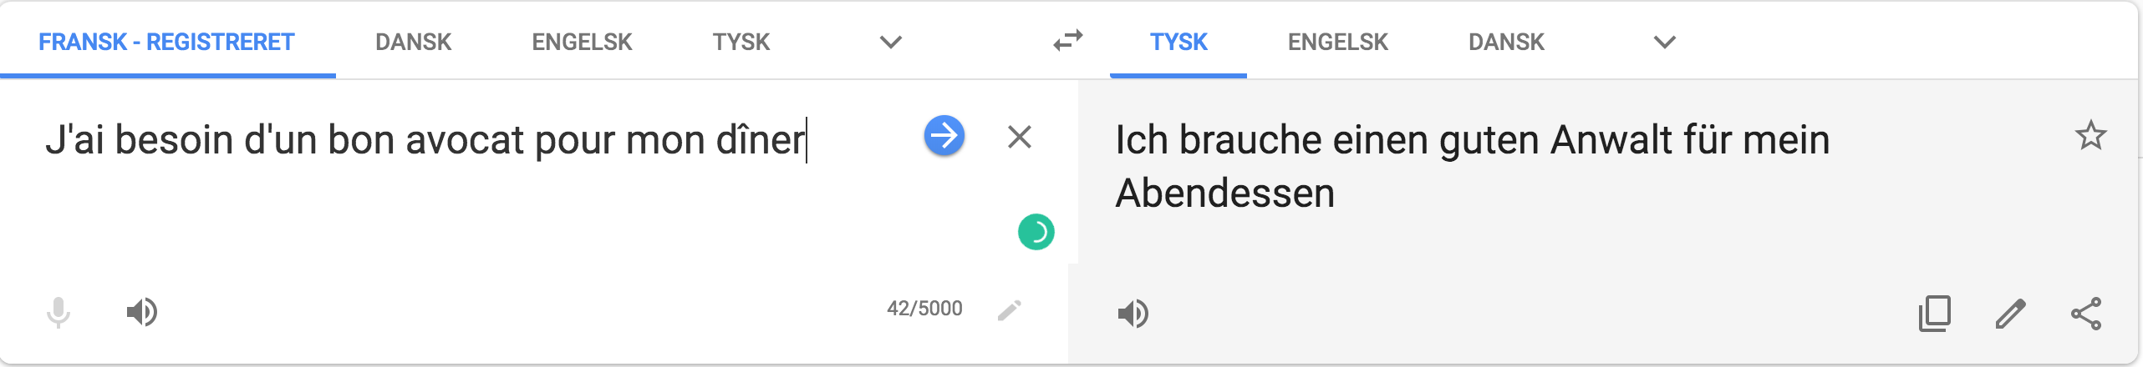
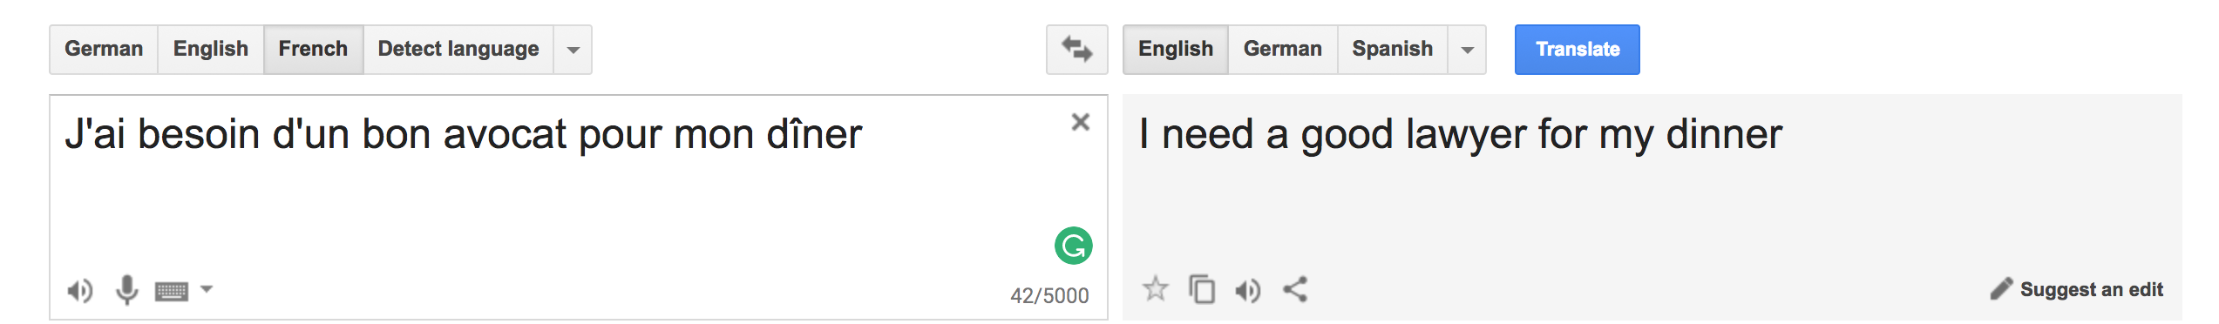
MT epic fails
And if you think this happens only for complicated languages such as Arabic and Chinese …
01/07/20
Language Technology Group – Chris Biemann

Slide 13
Machine Translation Paradigms
https://www.babelfish.com
The are 4 MT Paradigms:
Rule-based machine translation or RBMT
A RBMT system is based on linking the structure of the given input sentence with the structure of the foreign output sentence. To translate a sentence from French to English, one needs:
A dictionary that will map each French word to an appropriate English word.
Rules representing regular French sentence structure.
Rules representing regular English sentence structure.
Rules according to which one can relate these two structures together.
Example-based machine translation or EBMT
For example, if we train on the two sentences "Good postgraduate students in the CSE department are smart" and "Programmers are good people" we would be able to translate "Programmers in the CSE department are smart" by just substituting the appropriate parts of the sentences.
01/07/20
Language Technology Group – Chris Biemann

Slide 14
Machine Translation Paradigms
https://www.babelfish.com
The are 4 MT Paradigms:
Statistical machine translation or SMT
Mainly word or phrase-based translations
Translation are learned from actual data
Pro: Translations are learned automatically
Con: Difficult to model complex translation phenomena
Neural Machine Translation or NMT
NMT is a simple new architecture for getting machines to learn to translate by modeling the whole translation process as one big artificial neural network
The most common models in NMT are based on the encoder-decoder architecture
First, the source sentence is encoded into a vector of embeddings of fixed length from which a decoder (decoder) generates translations.
01/07/20
Language Technology Group – Chris Biemann

Slide 15
MT pipeline is similar to many
ML pipelines
Training
Learning component
Tuning
Performance component
Decoding
Evaluation component
Evaluating
01/07/20
Language Technology Group – Chris Biemann

Slide 16
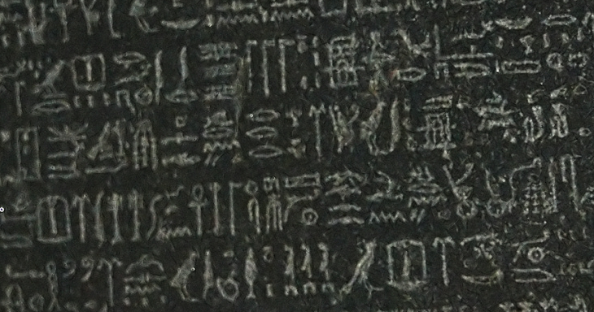
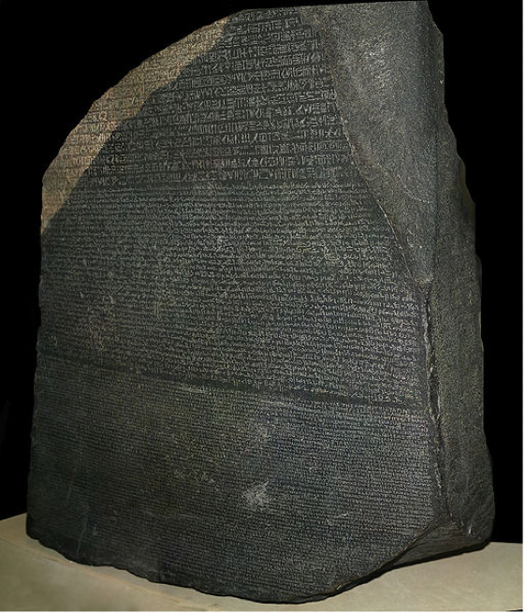
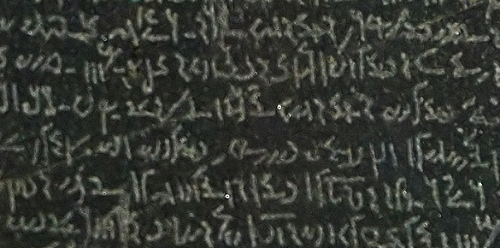

Parallel Corpus: Training resource for MT
Most popular:
EuroParl: European parliament protocols in 11 languages
Software manuals (KDE, Open Office …)
Parallel webpages
For the remainder, we assume that we have a sentence-aligned parallel corpus.
there are methods to get to aligned sentences from aligned documents
there are methods to extract parallel sentences from comparable corpora
01/07/20
Language Technology Group – Chris Biemann

Slide 17
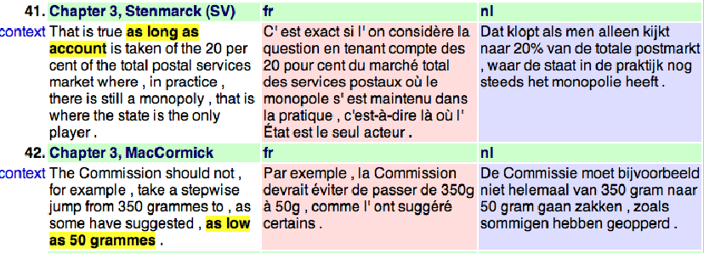
Parallel Corpus: Training resource for MT
01/07/20
Language Technology Group – Chris Biemann

Slide 18
Computing Translation Probabilities
Imagine that we want to translate from French (f) into English (e).
Given a parallel corpus we can estimate P(e | f). The maximum likelihood estimation of P(e | f) is: freq(e,f)/freq(f)
Way too specific to get any reasonable frequencies when done on the basis of sentences, vast majority of unseen data will have zero counts
P(e | f ) could be re-defined as:
Problem: The English words maximizing P(e | f ) might not result in a readable sentence
01/07/20
Language Technology Group – Chris Biemann

Slide 19
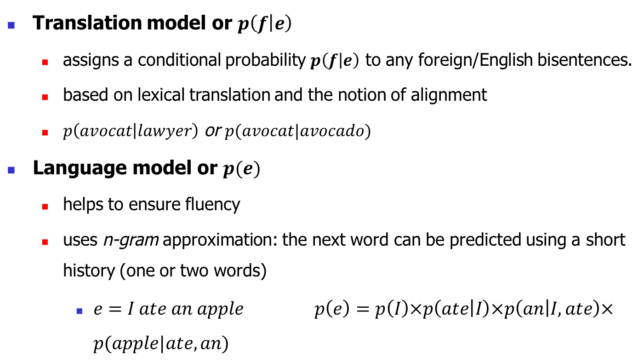
Training Problems for Statistical MT
Translation model or $p\left(f | e\right)$
assigns a conditional probability $p\left(f | e\right)$ to any foreign/English bisentences.
based on lexical translation and the notion of alignment
$p\left(avocat | lawyer\right)$ or $p(avocat|avocado)$
Language model or $p(e)$
helps to ensure fluency
uses n-gram approximation: the next word can be predicted using a short history (one or two words)
$e=I ate an apple$ $p\left(e\right)=p\left(I\right)×p\left(ate | I\right)×p\left(an | I,ate\right)×p(apple|ate,an)$
01/07/20
Language Technology Group – Chris Biemann
Notes:
n-gram approximation follows the Markov assumption that a future event (in this case, the next word) can be predicted using a relatively short history (for the example, one or two words)

Slide 20
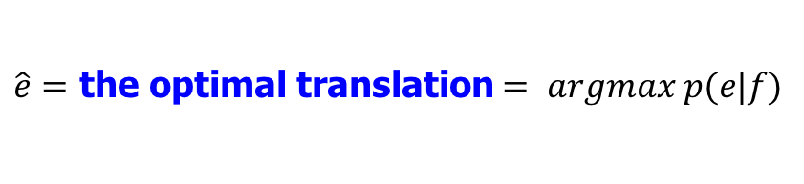
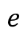
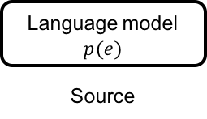
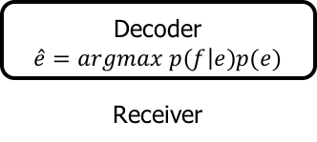
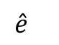
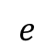
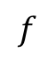
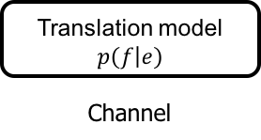
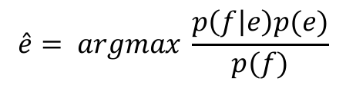
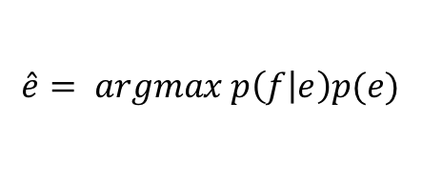
Combine the translation model and LM via the noisy channel approach
Noisy channel model using Bayes’ theorem:
$$e$$
$$f$$
$$\hat{e}$$
Language model $$p(e)$$
Source
Translation model $$p\left(f | e\right)$$ Channel
Decoder
$$\hat{e}=argmax p\left(f | e\right)p(e)$$
Receiver
Output
$\hat{e}=$ the optimal translation $= argmax p(e|f)$
$$e$$
$$\hat{e}= argmax \frac{p\left(f | e\right)p(e)}{p(f)}$$
$$e$$
Bayes’ inference
$$\hat{e}= argmax p\left(f | e\right)p(e)$$
$$e$$
the point estimate of the posterior
prior
likelihood
01/07/20
Language Technology Group – Chris Biemann
Notes:
we are interested on the best model that fits the data. Best model e is selected by considering how well it explains the date p(f|e) and how good it flows in general p(e)
Bayes’ theorem then shows that the posterior probabilities are proportional to the numerator:
e hat is th epoint estimate of the posterior
delete posterior
argmax is equal put return

Slide 21
Computing Translation Probabilities
We can account for adequacy: each foreign word translates into its most likely English word
We cannot guarantee that this will result in a fluent English sentence
Solution: transform P(e | f) with Bayes’ rule:
P(f | e) accounts for adequacy
P(e) accounts for fluency
01/07/20
Language Technology Group – Chris Biemann

Slide 22
Language Modeling: P(e)
Determine the probability of an English sequence P(e)
Can use n-gram models, PCFG-based models etc.: anything that assigns a probability for a sequence
Standard: n-gram model
Language model picks the most fluent translation of many possible translations
Language model can be estimated from a large monolingual corpus
01/07/20
Language Technology Group – Chris Biemann

Slide 23
Translation Modeling: P(f|e)
Determines the probability that the foreign word f_{j} is a translation of the English word e_{i}
How to compute P(f_{j} | e_{i}) from a parallel corpus? Need to align their translations
Statistical approaches rely on the co-occurrence of e_{i} and f_{j} in the parallel data: If e_{i} and f_{j} tend to co-occur in parallel sentence pairs, they are likely to be translations of one another
Commonly, four factors are used:
translation: How often do e_{i} and f_{j} co-occur?
distortion: How likely is a word occurring at position x to translate into a word occurring at position y? For example: English is a verb-second language, whereas German is a verb-final language
fertility: How likely is e_{i} to translate into more than one word? For example: “defeated” can translate into "eine Niederlage erleiden"
null translation: How likely is a foreign word to be spuriously generated?
01/07/20
Language Technology Group – Chris Biemann

Slide 24
IBM Models 1-5
Model 1: Bag of words
Unique local maxima
Efficient EM algorithm (Model 1–2)
Model 2: General alignment:
Model 3: fertility: n(k | e)
No full EM, count only neighbors (Model 3–5)
Leaky (Model 3–4)
Model 4: Relative distortion, word classes
Model 5: Extra variables to avoid leakiness
Models of lower orders are used to initialize models of higher orders
01/07/20
Language Technology Group – Chris Biemann

Slide 25
Word based alignment models
Learn word-to-word correlation between the input/source language and and the output/target language
Das große Haus ist schön
Schön ist das große Haus!
The big house is beautiful
The big house is beautiful
01/07/20
Language Technology Group – Chris Biemann

Slide 26
Alignment function: Definition
Formalizing an alignment with an alignment function a
Mapping a foreign input at position i with an English output at position j denoted i-j
Example:
a: {0-0, 1-1, 2-2}
01/07/20
Language Technology Group – Chris Biemann

Slide 27

IBM model 1
-1 0 1 2 3 4 5 6 7
NULL Yesterday is nothing but the memory of today
4 3 2 1 0
01/07/20
Language Technology Group – Chris Biemann

Slide 28
IBM Model 1
Simplest of the IBM models
Does not consider word order (bag-of-words approach)
Does not model one-to-many alignments
Computationally inexpensive
Useful for parameter estimations that are passed on to more elaborate models
Translation probability in terms of alignments:
where:
and:
01/07/20
Language Technology Group – Chris Biemann

Slide 29
IBM Models
Given an English sentence e¹… e^{l} and a foreign sentence f¹… f^{m}
We want to find the ‘best’ alignment a, where a is a set of pairs of the form {(i , j), . . . , (i’, j’)}, 0<= i , i’ <= l and 1<= j , j’<= m
Note that if (i , j), (i’, j) are in a, then i equals i’, i.e. no many-to-one alignments are allowed
We add a spurious NULL word to the English sentence at position 0
In total there are (l+1)^{m} different alignments A
Allowing for many-to-many alignments results in (2^{l})^{m} possible alignments A
01/07/20
Language Technology Group – Chris Biemann

Slide 30
IBM Model 1
We want to find the most likely alignment:
We don’t need to enumerate all alignments: Since P(f ^{j}|e^{i}) is independent from P(f ^{j’}|e^{i’}) we can find the maximum alignment by looking at the individual translation probabilities only
Let , then for each a_{j}:
The best alignment can be computed in a quadratic number of steps: m(l+1)
01/07/20
Language Technology Group – Chris Biemann

Slide 31
Computing Model 1 Parameters
Step 1: Determine candidates. For each English word e collect all foreign words f that co-occur at least once with e
Step 2: Initialize P(f|e) uniformly, i.e. P(f|e) = 1/(number of co-occurring foreign words) or P(f|e) = 1/(number of total foreign words)
Step 3: Iteratively refine translation probabilities with EM: for n iterations
set tc to zero
for each sentence pair (e,f) of lengths (l,m)
for j=1 to m
total=0;
for i=1 to l: total += P(f^{j}|e^{i});
for i=1 to l: tc(f^{j}|e^{i}) += P(f^{j}|e^{i})/total;
for each word e
total=0;
for each word f s.t. tc(f|e) is defined: total += tc(f|e);
for each word f s.t. tc(f|e) is defined: P(f|e) = tc(f|e)/total;
01/07/20
Language Technology Group – Chris Biemann

Slide 32
IBM Model 1 example
Parallel ‘corpus’:
the dog :: der Hund
the tomcat :: der Kater
Step 1+2 (collect candidates and initialize uniformly):
P(der|the) = P(Hund|the) = P(Kater|the) = 1/3
P(der|dog) = P(Hund|dog) = P(Kater|dog) = 1/3
P(der|tomcat) = P(Hund|tomcat) = P(Kater|tomcat) = 1/3
P(der|NULL) = P(Hund|NULL) = P(Kater|NULL) = 1/3
Step 3: Iterate
NULL the dog :: der Hund
j=1
total = P(der|NULL)+P(der|the)+P(der|dog)= 1
tc(der|NULL) += P(der|NULL)/1 = 0 += .333/1 = 0.333
tc(der|the) += P(der|the)/1 = 0 += .333/1 = 0.333
tc(der|dog) += P(der|dog)/1 = 0 += .333/1 = 0.333
j=2
total = P(Hund|NULL)+P(Hund|the)+P(Hund|dog)=1
tc(Hund|NULL) += P(Hund|NULL)/1 = 0 += .333/1 = 0.333
tc(Hund|the) += P(Hund|the)/1 = 0 += .333/1 = 0.333
tc(Hund|dog) += P(Hund|dog)/1 = 0 += .333/1 = 0.333
01/07/20
Language Technology Group – Chris Biemann

Slide 33
IBM Model 1 example
NULL the tomcat :: der Kater
j=1
total = P(der|NULL)+P(der|the)+P(der|tomcat)=1
tc(der|NULL) += P(der|NULL)/1 = 0.333 += .333/1 = 0.666
tc(der|the) += P(der|the)/1 = 0.333 += .333/1 = 0.666
tc(der|tomcat) += P(der|tomcat)/1 = 0 +=.333/1 = 0.333
Re-compute translation probabilities
total(the) = tc(der|the) + tc(Hund|the) + tc(Kater|the) = 0.666 + 0.333 + 0.333 = 1.333
P(der|the) = tc(der|the)/total(the) = 0.666 / 1.333 = 0.5
P(Hund|the) = tc(Hund|the)/total(the) = 0.333/1.333 = 0.25
P(Kater|the) = tc(Kater|the)/total(the) = 0.333/1.333 = 0.25
total(dog) = tc(der|dog) + tc(Hund|dog) = 0.666
P(der|dog) = tc(der|dog)/total(dog) = 0.333 / 0.666 = 0.5
P(Hund|dog) = tc(Hund|dog)/total(dog) = 0.333 / 0.666 = 0.5
total(tomcat) = tc(der|tomcat) + tc(Kater|tomcat) = 0.333 + 0.333 =0.666
P(der|tomcat) = P(Kater|tomcat) = 0.5
total(NULL) = tc(der|NULL) + tc(Hund|NULL) + tc(KATER|NULL) = 0.666 + 0.333 + 0.333 = 1.333
P(der|NULL) = 0.5 P(Hund|NULL) = 0.25 P(Kater|NULL) = 0.25
j=2
total = P(Kater|NULL)+P(Kater|the)+P(Kater|tomcat)=1
tc(Kater|NULL) += P(Kater|NULL)/1 = 0 += .333/1 = 0.333
tc(Kater|the) += P(Kater|the)/1 = 0 += .333/1 = 0.333
tc(Kater|tomcat) += P(Kater|tomcat)/1 = 0 += .333/1 = 0.333
01/07/20
Language Technology Group – Chris Biemann

Slide 34
IBM Model 1 example
Iteration 2:
NULL the dog :: der Hund
j=1
total = P(der|NULL)+P(der|the)+P(der|dog) = 0.5 + 0.5 + 0.5 = 1.5
tc(der|NULL) += P(der|NULL)/1.5 = 0 += .5/1.5 = 0.333
tc(der|the) += P(der|the)/1.5 = 0 += .5/1.5 = 0.333
tc(der|dog) += P(der|dog)/1.5= 0 += .5/1.5 = 0.333
NULL the tomcat :: der Kater
j=1
total = P(der|NULL)+P(der|the)+P(der|tomcat)
= 0.5 + 0.5 + 0.5 = 1.5
tc(der|NULL) += P(der|NULL)/1.5 = 0.333 += .5/1.5 = 0.666
tc(der|the) += P(der|the)/1.5 = 0.333 += .5/1.5 = 0.666
tc(der|tomcat) += P(der|tomcat)/1.5= 0 += .5/1.5 = 0.333
j=2
total = P(Hund|NULL)+P(Hund|the)+P(Hund|dog) = 0.25 + 0.25 + 0.5 = 1
tc(Hund|NULL) += P(Hund|NULL)/1 = 0 += .25/1 = 0.25
tc(Hund|the) += P(Hund|the)/1 = 0 += .25/1 = 0.25
tc(Hund|dog) += P(Hund|dog)/1 = 0 += .5/1 = 0.5
j=2
total = P(Kater|NULL)+P(Kater|the)+P(Kater|tomcat) = 0.25 + 0.25 + 0.5 = 1
tc(Kater|NULL) += P(Kater|NULL)/1 = 0 += .25/1 = 0.25
tc(Kater|the) += P(Kater|the)/1 = 0 += .25/1 = 0.25
tc(Kater|tomcat) += P(Kater|tomcat)/1 = 0 += .5/1 = 0.5
01/07/20
Language Technology Group – Chris Biemann

Slide 35
IBM Model 1 example: Probs after Iteration 2
Re-compute translations (iteration 2):
total(the) = tc(der|the) + tc(Hund|the) + tc(Kater|the) = .666 + 0.25 + 0.25 = 1.166
P(der|the) = tc(der|the)/total(the) = .666 / 1.166= 0.57
P(Hund|the) = tc(Hund|the)/total(the) = 0.25/1.166 = 0.214
P(Kater|the) = tc(Kater|the)/total(the) = 0.25/1.166 = 0.214
total(dog) = tc(der|dog) + tc(Hund|dog) = 0.333 + 0.5 = 0.833
P(der|dog) = tc(der|dog)/total(dog) = 0.333 / 0.833 = 0.4
P(Hund|dog) = tc(Hund|dog)/total(dog) = 0.5 / 0.833 = 0.6
total(tomcat) = tc(der|tomcat) + tc(Kater|tomcat) = 0.333 + 0.5 = 0.833
P(der|tomcat) = 0.4 P(Kater|tomcat) = 0.6
total(NULL) = tc(der|NULL) + tc(Hund|NULL) + tc(KATER|NULL) = .666 + 0.25+ 0.25 = 1.166
P(der|NULL) = 0.57 P(Hund|NULL) = 0.214 P(Kater|NULL) = 0.214
➔Slowly, this example converges to the true translations
01/07/20
Language Technology Group – Chris Biemann

Slide 36
From Model 1 to Model 3
Model 1
IBM Model 1 allows for an efficient computation of translation probabilities
No notion of fertility, i.e., it is possible that the same English word is the best translation for all foreign words
No positional information, i.e., depending on the language pair, there might be a tendency that words occurring at the beginning of the English sentence are more likely to align to words at the beginning of the foreign sentence
Model 2+3
(3) Fertility: how likely does a single word align to several words
(2) Distortion: how likely is the alignment of a word in position i with a word in position j?
01/07/20
Language Technology Group – Chris Biemann

Slide 37
Model 2
-1 0 1 2 3 4 5 6 7
NULL Yesterday is nothing but the memory of today
today memory nothing but yesterday not
4 3 2 1 0
01/07/20
Language Technology Group – Chris Biemann
Notes:
Missing space after right parenthesis
Bad indentation on second bullet

Slide 38
Model 2
Adds a new parameter that estimates the alignment
The input word alignment affect the alignment probability
Introduces , the probability that the output word i is mapped to the input word at position j
Changes the translation probability to:
01/07/20
Language Technology Group – Chris Biemann

Slide 39







Model 3
-1 0 1 2 3 4 5 6 7 8
NULL naturally yesterday is nothing but the memory of today
naturally naturally yesterday nothing but memory today
Null insertion
NULL naturally naturally yesterday nothing but memory today
6 5 4 3 2 1 0
01/07/20
Language Technology Group – Chris Biemann

Slide 40
Model 3
-1 0 1 2 3 4 5 6 7 8
NULL naturally yesterday is nothing but the memory of today
n(2|naturally)
naturally naturally yesterday nothing but memory today
Null insertion
NULL naturally naturally yesterday nothing but memory today
<>
6 5 4 3 2 1 0
01/07/20
Language Technology Group – Chris Biemann

Slide 41
Model 3
Adds the notion of fertility to model 1 and 2. Fertility represents how many are generated from each input or the fertility
Adds a NULL insertion step for all the words that get mapped to epsilon
Models the distortion which produces a foreign output position conditioned on the foreign input (Koehn 2010)
01/07/20
Language Technology Group – Chris Biemann

Slide 42
Model 2
Fixes the model deficiency of models 1-4
Includes heuristics that would prohibit the placement of an output word in a position already taken
Places words in free memory position
Distributes the probability mass to valid alignments
01/07/20
Language Technology Group – Chris Biemann

Slide 43
Fertility
The best Model 1 alignment could be that a single English word aligns to all foreign words
This is clearly not desirable and we want to constrain the number of words an English word can align to
Fertility models a probability distribution that word e aligns to k words: n(k,e)
Consequence: translation probabilities cannot be computed independently of each other anymore
IBM Model 3 has to work with full alignments, note there are up to (l+1)^{m} different alignments: this is infeasible
Solution: Compute the best alignment with Model 1 and change some of the alignments to generate a set of likely alignments (pegging)
Model 3 takes this restricted set of alignments as input
01/07/20
Language Technology Group – Chris Biemann

Slide 44
Neighborhood of an alignment
Fertility
Given an alignment a we can derive additional alignments from it by making small changes:
Changing a link (j,i) to (j,i’)
Swapping a pair of links (j,i) and (j’,i’) to (j,i’) and (j’,i)
The resulting set of alignments is called the neighborhood of a
Distortion
The distortion factor determines how likely it is that an English word in position i aligns to a foreign word in position j, given the lengths of both sentences: d(j | i, l, m). Note: positions are absolute positions
Then, use EM on the neighborhoods to find a better alignment
01/07/20
Language Technology Group – Chris Biemann

Slide 45
Deficiency: Leaky model!
Problem with IBM Model 3: It assigns probability mass to impossible strings
Well formed string: “This is possible”
Ill-formed but possible string: “This possible is”
Impossible string:
Impossible strings are due to distortion values that generate different words at the same position
Impossible strings can still be filtered out in later stages of the translation process
Again, leaky models are functional, but waste probability mass on impossible events.
“possible
This
is”
01/07/20
Language Technology Group – Chris Biemann

Slide 46
Limitations of IBM models (1-5)
Only 1-to-N word mapping
Handling fertility-zero words (difficult for decoding)
Almost no syntactic information
Word classes
Relative distortion
parse trees
Long-distance word movement
Fluency of the output depends entirely on the English language model
01/07/20
Language Technology Group – Chris Biemann

Slide 47
Phrase-Based Statistical MT
Morgen
fliege
ich
nach Kanada
zur Konferenz
Tomorrow
I
will fly
to the conference
In Canada
Foreign input segmented into phrases
“phrase” is any sequence of words
Each phrase is probabilistically translated into English
P(to the conference | zur Konferenz)
P(into the meeting | zur Konferenz)
Phrases are probabilistically re-ordered
01/07/20
Language Technology Group – Chris Biemann

Slide 48
Word Alignment Induced Phrases
Maria no dió una bofetada a la bruja verde
Mary
did
not
slap
the
green
witch
(Maria, Mary) (no, did not) (slap, dió una bofetada) (la, the) (bruja, witch) (verde, green)
01/07/20
Language Technology Group – Chris Biemann

Slide 49
How to learn the phrase translation table?
Maria no dió una bofetada a la bruja verde
Mary
did
not
slap
the
green
witch
one
example
phrase
pair
Collect all phrase pairs that are consistent with the word alignment
01/07/20
Language Technology Group – Chris Biemann

Slide 50
Consistent with Word Alignment
Maria no dió
Maria no dió
Maria no dió
Mary
did
not
slap
Mary
did
not
slap
 | x
Mary
did
not
slap
 |  | x
consistent
inconsistent
inconsistent
Phrase alignment must contain all alignment points for all the words in both phrases!
01/07/20
Language Technology Group – Chris Biemann

Slide 51
GIZA++ uses heuristics such as union to combine the alignments
Maria
no
daba
una
bofetada
a
la
bruja
verde
Maria
no
daba
una
bofetada
a
la
bruja
verde
Union
Correct
Over aligning
Maria
did
not
slap
the
green
witch
Maria
did
not
slap
the
green
witch
01/07/20
Language Technology Group – Chris Biemann

Slide 52
GIZA++ uses heuristics such as union to combine the alignments
Maria
no
daba
una
bofetada
a
la
bruja
verde
Maria
no
daba
una
bofetada
a
la
bruja
verde
Missing
alignments
Intersection
Correct
Maria
did
not
slap
the
green
witch
Maria
did
not
slap
the
green
witch
01/07/20
Language Technology Group – Chris Biemann

Slide 53
Word Alignment Induced Phrases
Human alignment
they were stolen on the subway in the morning
它们 今天 早上 在 地铁 上 被 偷的
01/07/20
Language Technology Group – Chris Biemann

Slide 54
Word Alignment Induced Phrases
Human alignment
they were stolen on the subway in the morning
它们 今天 早上 在 地铁 上 被 偷的
01/07/20
Language Technology Group – Chris Biemann

Slide 55
Word Alignment Induced Phrases
Human phrase extraction
they were stolen on the subway in the morning
它们 今天 早上 在 地铁 上 被 偷的
01/07/20
Language Technology Group – Chris Biemann

Slide 56
Advantages of Phrase-based SMT
Many-to-many mappings can handle non-compositional phrases
takes both directions into account
Local context is very useful for disambiguating
“Interest rate” → …
“Interest in” → …
The more data, the longer the learned phrases: Sometimes whole sentences
01/07/20
Language Technology Group – Chris Biemann

Slide 57
Decoding
Goal is to find a translation that maximizes the product of the translation and language models.
Cannot explicitly enumerate and test the combinatorial space of all possible translations.
Must efficiently (heuristically) search the space of translations that approximates the solution to this difficult optimization problem.
The optimal decoding problem for all reasonable models (e.g. IBM model 1) is NP-complete.
Here:
phrase-based decoder based on that of Koehn’s (2004) Pharaoh system.
Pharaoh: a Beam Search Decoder for Phrase-Based Statistical Machine Translation Models, Philipp Koehn, AMTA 2004
01/07/20
Language Technology Group – Chris Biemann

Slide 58
Space of Translations
Maria | no | dio | una | bofetada | a | la | bruja | verde
Mary
not
give
a
slap
to
the
witch
green
did not
a slap
to the
green witch
no
slap
to
did not give
the
slap
the witch
The phrase translation table from the alignment defines the space of possible translations
every word can have multiple translations
every word can participate in multiple phrases
01/07/20
Language Technology Group – Chris Biemann

Slide 59
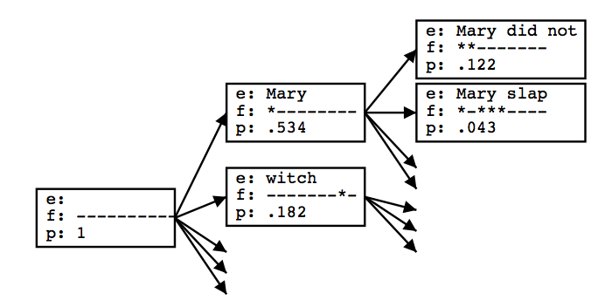
Stack Decoding
Use a version of heuristic A* search to explore the space of phrase translations to find the best scoring subset that covers the source sentence.
Initialize priority queue Q (stack) to empty translation.
Loop:
s = pop(Q)
If h is a complete translation, exit loop and return it.
For each refinement s´ of s created by adding a phrase translation
Compute score f(s´)
Add s´ to Q
Sort Q by score f
01/07/20
Language Technology Group – Chris Biemann

Slide 60
Search Heuristic
A* is best-first search using the function f to sort the search queue:
f(s) = g(s) + h(s)
g(s): Cost of existing partial solution
h(s): Estimated cost of completion of solution
If h(s) is an underestimate of the true remaining cost (admissible heuristic) then A* is guaranteed to return an optimal solution.
Known quality of partial translation, E, composed of a set of chosen phrase translations S based on phrase translation and language models:
01/07/20
Language Technology Group – Chris Biemann

Slide 61
Estimating the future cost
True future cost requires knowing the way of translating the remainder of the sentence in a way that maximizes the probability of the final translation.
However, this is not computationally tractable.
Therefore under-estimate the cost of remaining translation by ignoring the distortion component and computing the most probable remaining translation ignoring distortion (which is efficiently computable using the Viterbi algorithm)
01/07/20
Language Technology Group – Chris Biemann

Slide 62
Beam Search
However, Q grows too large to be efficient and guarantee an optimal result with full A* search.
Therefore, always cut Q back to only the best (lowest cost) K items to approximate the best translation
Initialize priority queue Q (stack) to empty translation.
Loop:
If top item on Q is a complete translation, exit loop and return it.
For each element s of Q do
For each refinement s´ of s created by adding a phrase translation
Compute score f(s´)
Add s´ to Q
Sort Q by score f
Prune Q back to only the first (lowest cost) K items
01/07/20
Language Technology Group – Chris Biemann

Slide 63
Multistack decoding
It is difficult to compare translations that cover different fractions of the foreign sentence, so maintain multiple priority queues (stacks), one for each subset of foreign words currently translated.
this prevents us from pruning solutions that cover all words: we prune per stack
Finally, return best scoring translation in the queue of translations that cover all of the words in F.
01/07/20
Language Technology Group – Chris Biemann

Slide 64
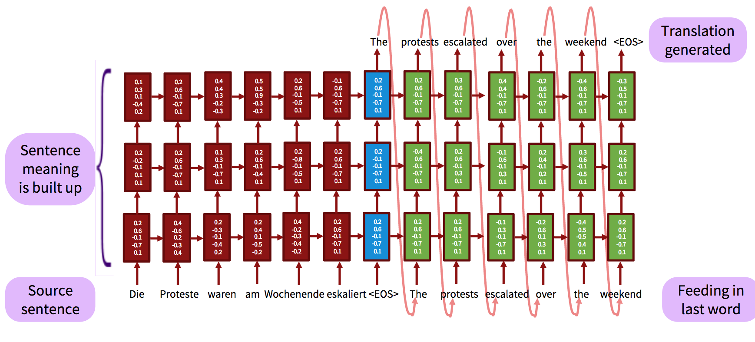
Sequence to Sequence Neural MT
Encoding/decoding with (recurrent) LSTMs
Ilya Sutskever, Oriol Vinyals, and Quoc Le. 2014. Sequence to Sequence Learning with Neural Networks, Proc. NIPS 2014
Tutorial: see https://nlp.stanford.edu/projects/nmt/Luong-Cho-Manning-NMT-ACL2016-v4.pdf
01/07/20
Language Technology Group – Chris Biemann

Slide 65
Advantages of Neural MT
End-to-End training: all parameters are simultaneously optimized
Distributed dense-vector representations: exploits word similarities
‘Infinite’ context: neural models better make use of long-range contexts
01/07/20
Language Technology Group – Chris Biemann

Slide 66
MT Evaluation
Manual:
SSER (subjective sentence error rate)
Correct/Incorrect
Error categorization
Testing in an application that uses MT as one sub-component
Question answering from foreign language documents
Cross Language Information Retrieval
Automatic:
BLEU (Bilingual Evaluation Understudy)
YiSi
01/07/20
Language Technology Group – Chris Biemann

Slide 67
BLEU Evaluation Metric
Reference (human) translation: The U.S. island of Guam is maintaining a high state of alert after the Guam airport and its offices both received an e-mail from someone calling himself the Saudi Arabian Osama bin Laden and threatening a biological/chemical attack against public places such as the airport .
N-gram precision (score is in [0,1] )
What percentage of machine n-grams can be found in the reference translation?
Not allowed to use same portion of reference translation twice (can’t cheat by typing out “the the the the the”)
Brevity penalty
Can’t just type out single word “the” (precision 1.0!)
Amazingly hard to “game” the system (i.e., find a way to change machine output so that BLEU goes up, but quality doesn’t)
Machine translation: The American [?] international airport and its the office all receives one calls self the sand Arab rich business [?] and so on electronic mail , which sends out ; The threat will be able after public place and so on the airport to start the biochemistry attack , [?] highly alerts after the maintenance.
01/07/20
Language Technology Group – Chris Biemann

Slide 68
BLEU Evaluation Metric
Reference (human) translation: The U.S. island of Guam is maintaining a high state of alert after the Guam airport and its offices both received an e-mail from someone calling himself the Saudi Arabian Osama bin Laden and threatening a biological/chemical attack against public places such as the airport .
BLEU4 formula
(counts n-grams up to length 4)
exp (1.0 * log p1 +
0.5 * log p2 +
0.25 * log p3 +
0.125 * log p4 –
max(words-in-reference / words-in-machine – 1, 0) )
p1 = 1-gram precision
p2 = 2-gram precision
p3 = 3-gram precision
p4 = 4-gram precision
Machine translation: The American [?] international airport and its the office all receives one calls self the sand Arab rich business [?] and so on electronic mail , which sends out ; The threat will be able after public place and so on the airport to start the biochemistry attack , [?] highly alerts after the maintenance.
01/07/20
Language Technology Group – Chris Biemann

Slide 69
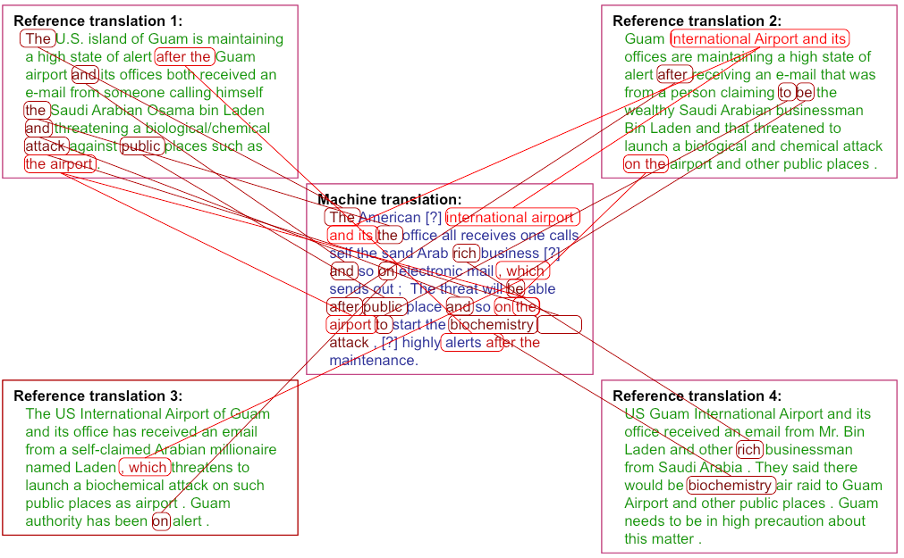
Multiple reference translations
Reference translation 1: The U.S. island of Guam is maintaining a high state of alert after the Guam airport and its offices both received an e-mail from someone calling himself the Saudi Arabian Osama bin Laden and threatening a biological/chemical attack against public places such as the airport .
Reference translation 1: The U.S. island of Guam is maintaining a high state of alert after the Guam airport and its offices both received an e-mail from someone calling himself the Saudi Arabian Osama bin Laden and threatening a biological/chemical attack against public places such as the airport .
Reference translation 2: Guam International Airport and its offices are maintaining a high state of alert after receiving an e-mail that was from a person claiming to be the wealthy Saudi Arabian businessman Bin Laden and that threatened to launch a biological and chemical attack on the airport and other public places .
Reference translation 2: Guam International Airport and its offices are maintaining a high state of alert after receiving an e-mail that was from a person claiming to be the wealthy Saudi Arabian businessman Bin Laden and that threatened to launch a biological and chemical attack on the airport and other public places .
Machine translation: The American [?] international airport and its the office all receives one calls self the sand Arab rich business [?] and so on electronic mail , which sends out ; The threat will be able after public place and so on the airport to start the biochemistry attack , [?] highly alerts after the maintenance.
Machine translation: The American [?] international airport and its the office all receives one calls self the sand Arab rich business [?] and so on electronic mail , which sends out ; The threat will be able after public place and so on the airport to start the biochemistry attack , [?] highly alerts after the maintenance.
Reference translation 3: The US International Airport of Guam and its office has received an email from a self-claimed Arabian millionaire named Laden , which threatens to launch a biochemical attack on such public places as airport . Guam authority has been on alert .
Reference translation 3: The US International Airport of Guam and its office has received an email from a self-claimed Arabian millionaire named Laden , which threatens to launch a biochemical attack on such public places as airport . Guam authority has been on alert .
Reference translation 4: US Guam International Airport and its office received an email from Mr. Bin Laden and other rich businessman from Saudi Arabia . They said there would be biochemistry air raid to Guam Airport and other public places . Guam needs to be in high precaution about this matter .
Reference translation 4: US Guam International Airport and its office received an email from Mr. Bin Laden and other rich businessman from Saudi Arabia . They said there would be biochemistry air raid to Guam Airport and other public places . Guam needs to be in high precaution about this matter .
01/07/20
Language Technology Group – Chris Biemann

Slide 70
BLEU considers MT_1 to be a descent translation
Input Il visit son pays natal demain pour célébrer l’anniversaire de sa maman
MT_1 He is out his country to his mother ’s birthday
Reference Tomorrow, he visits his original country to celebrate his mother ’s birthday
n-gram matchings
1-gram matches: | 7
2-gram matches: | 4
3-gram matches: | 2
4-gram matches: | 1
01/07/20
Language Technology Group – Chris Biemann

Slide 71
BLEU considers MT_1 to be better than MT_2
Input Il visite son pays natal demain pour célébrer l’anniversaire de sa maman
MT_1 He is out his country to his mother’s birthday
MT_2 He goes back home to celebrate the birthday of his mama
Reference Tomorrow, he visits his original country to celebrate his mother’s birthday
n-gram matchings MT_1
1-gram matches: | 7
2-gram matches: | 4
3-gram matches: | 2
4-gram matches: | 1
n-gram matchings MT_2
1-gram matches: | 5
2-gram matches: | 1
3-gram matches: | 0
4-gram matches: | 0
01/07/20
Language Technology Group – Chris Biemann

Slide 72
What makes a translation useful?
How well is
who did what to whom, for whom, when, where, why and how
preserved in translation?
01/07/20
Language Technology Group – Chris Biemann

Slide 73
Semantic based evaluation
English
English
ARG0
PRED
ARG-LOC
ARG-TMP
ARG-PRP
REF He goes to his home tomorrow for his mother's birthday
MT Tomorrow, he enters home for mother birthday
ARG-TMP
ARG0
PRED
ARG1
ARG-PRP
01/07/20
Language Technology Group – Chris Biemann

Slide 74
Semantic based evaluation
MT_2 He goes back home to celebrate the birthday of his mama
Reference Tomorrow, he visits his original country to celebrate his mother’s birthday
who
verb
where
why
who
what
where
why
SRL matchings
Predicate matches: | 2
Argument matches: | 8
 | 0
 | 0
01/07/20
Language Technology Group – Chris Biemann

Slide 75
Semantic based evaluation
Input Il visit son pays natal demain pour célébrer l’anniversaire de sa maman
MT_1 He is out his country to his mother’s birthday
MT_2 He goes back home to celebrate the birthday of his mama
Reference Tomorrow, he visits his original country to celebrate his mother’s birthday
SRL matchings MT_1
Predicate matches: | 0
Argument matches: | 0
SRL matchings MT_2
Predicate matches: | 2
Argument matches: | 8
01/07/20
Language Technology Group – Chris Biemann

Slide 76
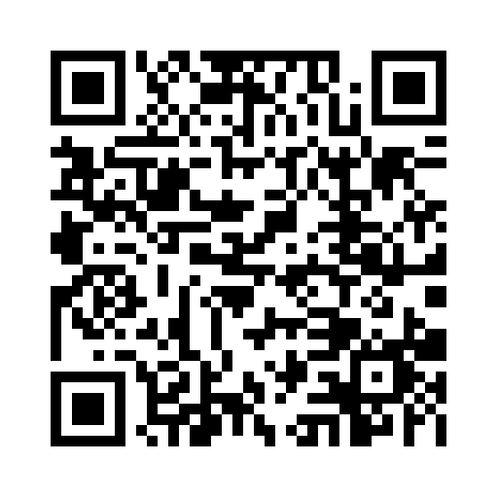


Immediate Feedback
s

